Slide 1
Bike Buyers Analysis: Predicting Purchase Behavior
Made By Sofia Crasto Data Analyst

Slide 2
Project Overview
Objective: Understand customer traits influencing bike purchases
Dataset: 1,000+ records, demographic + behavioral features
Tools Used: Excel (Pivot Tables, Dashboard)

Slide 3

Business Context
Why this matters: Marketing, product targeting, regional strategy

Slide 4
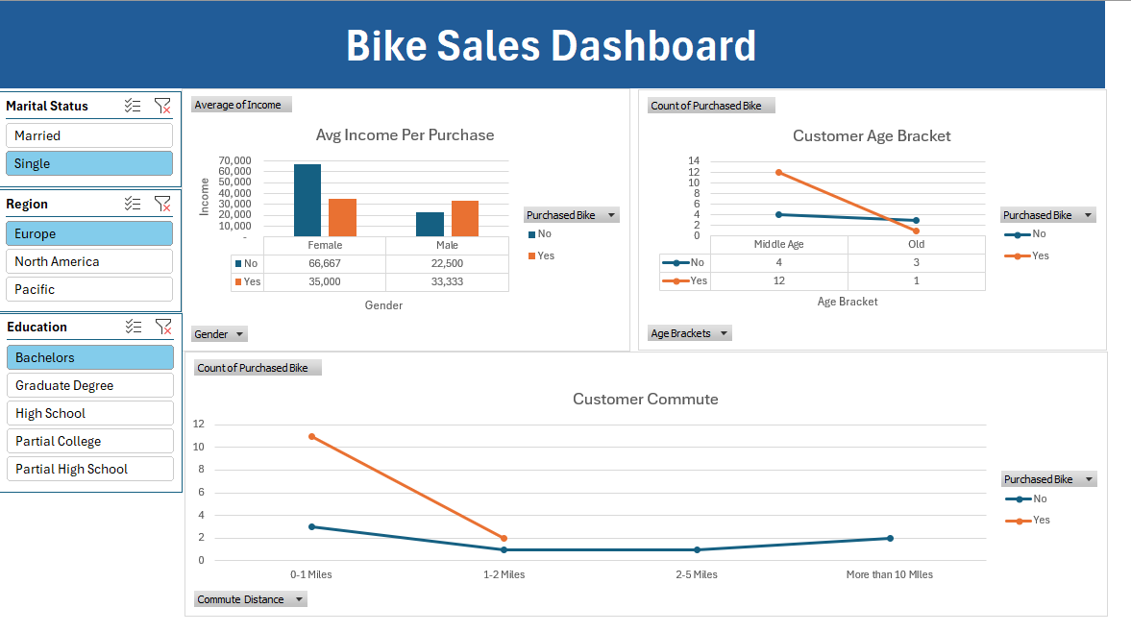
Dashboard Snapshot

Slide 5
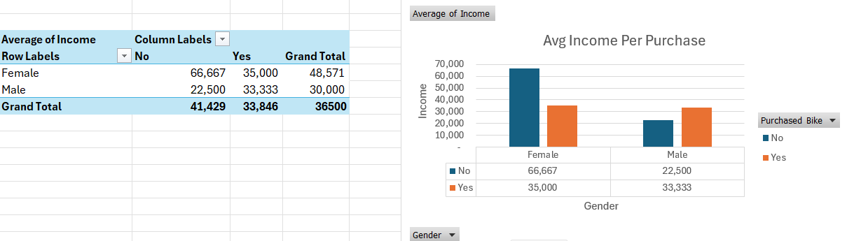
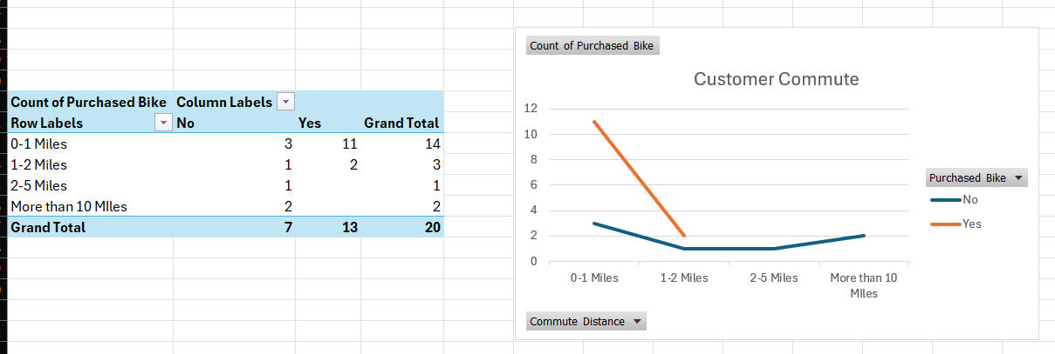
Feature Insights
Use charts to show:
Purchase rate by Income bracket
Purchase rate by Occupation
Purchase rate by Commute Distance

Slide 6

Insights & Strategic Recommendations
🔍 Key Findings
Income and Occupation are the strongest predictors of bike purchase.
Customers with commute distances over 10 miles are more likely to buy.
Single professionals in the Pacific region show high conversion rates.
💼 Business Recommendations
Target high-income commuters with tailored offers and messaging.
Focus campaigns on Pacific and North America regions for higher ROI.
Bundle bikes with car accessories to appeal to dual-vehicle households.

